Slide 1
The Future of Damage Prevention
Presented by: Kris Philpott
ORCGA 2018
Blue Mountain
Damage Prevention Symposium 2018

Slide 2
What Does the Future Hold?
Better…..
Faster….
Less…..
More accurate…..
Notes:
5 minutes.
All great ideas but are we on a path to get us there today?

Slide 3
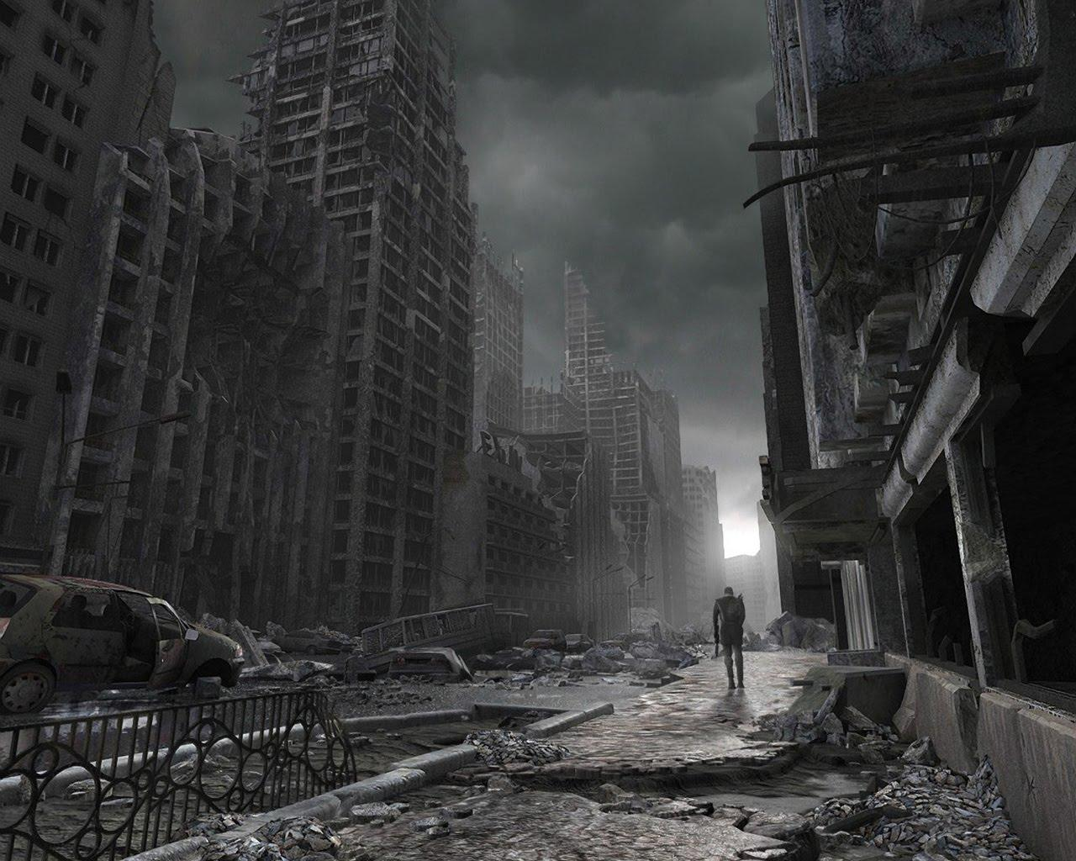
Notes:
All great ideas….but are we heading in that direction?

Slide 4
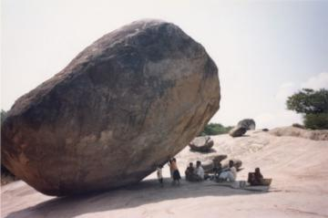
Is the system broken?
Are we struggling with the current system?
If we do nothing will we arrive in Utopia?
Notes:
6 minutes.
We all know the current approach to locates and damage prevention is not scalable. With a year over year increase in locate requests, our current system is destined for failure. Kris will prove this and speak to various opportunities such as;

Slide 5
How can we test our current model?
Notes:
Big data / machine learning / simulations
When we crunch the numbers they represent something similar to the dooms day picture. However, a talk at ORCGA just showing numbers is boring…..

Slide 6
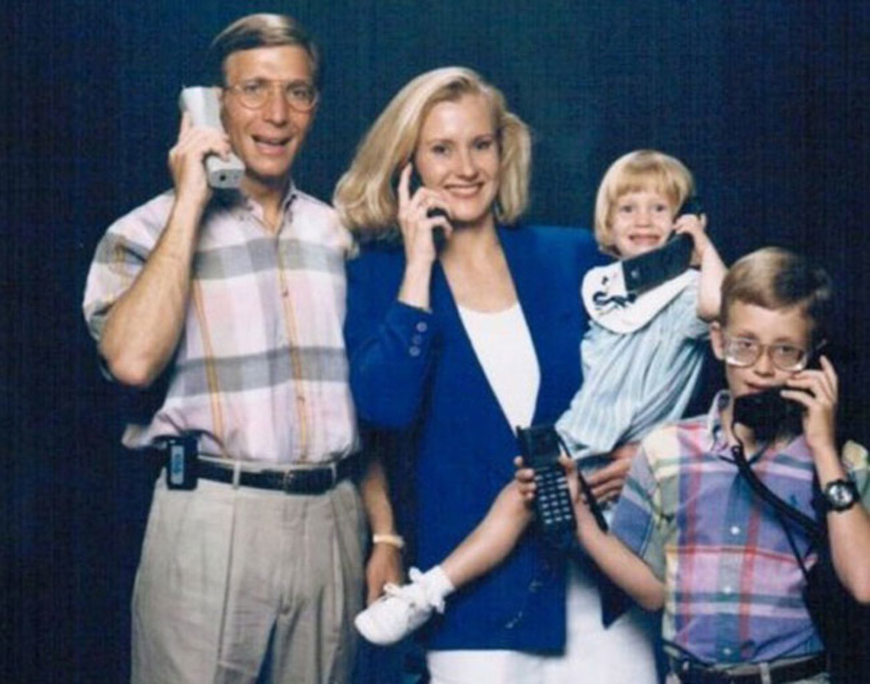
Notes:
10 minutes
We decided to put my busy family to the test…..

Slide 7
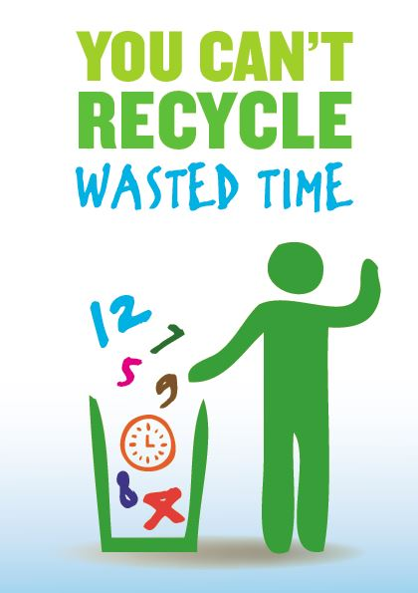
Adopting our Locate Model to my Life
Family Experiment
Grocery Shopping
Notes:
12 minutes.
We made a grocery list for each meal. I was assigned to buying meat, while my wife was assigned to everything else.
We could buy only a few items from our list each day. We were not allowed to discuss our shopping plans and simply hoped that our supplies would align to make the meals.
On the first day, I drove to Longo’s about 20km from our house to buy the best steak. Then I drove to Zerhs, which is near our house, to by lunch meat. I was happy with my work for the day and went home for dinner.
Surely you can imagine that my wife first went to Zerhs and then to Longo’s……

Slide 8
Adopting our Locate Model to my Life
Family Experiment
Hockey Schedule
Notes:
15 minutes
Asked my youngest to hand make our hockey schedules….and maintained the schedule for each change.
We missed a few games and practices. We went to the rink on the wrong days and many times we went to the wrong rink in the wrong town.

Slide 9
Adopting our Locate Model to my Life
Family Experiment
Snow Man
Notes:
17 minutes
Snow Man – we chose weather as our thing to represent something completely out of our control.
We built a snowman. The weather melted the snow man…..kids crying….waited for more snow….built a snowman….repeat.

Slide 10
Adopting our Locate Model to my Life
Family Experiment
Holiday Gift Cards
Notes:
20 minutes
5 gift cards given to our kids over the next several days….from your extended family.
You can only use them once you have all 5. Uncle Jeff was really busy and could not visit for 15 days. Some expire after 30 days, some after 60 days.
We will drive you to the mall once you have all 5, unless:
It is raining
It is too cold or too hot
We don’t have plans (hockey)
We can only go on week days
-There were fewer than 9 days to go to the mall.

Slide 11
Adopting our Locate Model to my Life
Comparisons
Grocery Shopping = Duplication of Locators
Hockey Schedule = Poor Records
Snow Man = Remarks
Gifts Cards = No Excavation/wasted locate
Notes:
25 minutes

Slide 12
Locator Paradox
Notes:
35 Minutes
How many locates per day can 1 locator complete?

Slide 13
Not Scalable
Notes:
37 minutes

Slide 14
How my family fixed it….
Grocery Shopping: = We sent one person to shop
Hockey Schedule = We synced our calendars with a live feed
Snow Man = We took a picture of the snowman
Gifts Cards = With the other items resolved…we had plenty of time.
Notes:
40 minutes

Slide 15
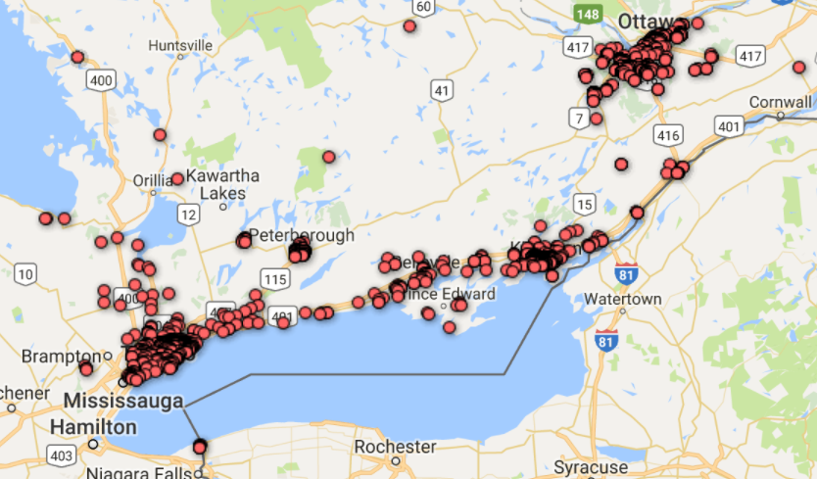
Enough with the bad data!
Infrastructure owners need quality records
Pilot Project:
30 Inspectors
18,500 images
2 Years
Notes:
45 minutes

Slide 16
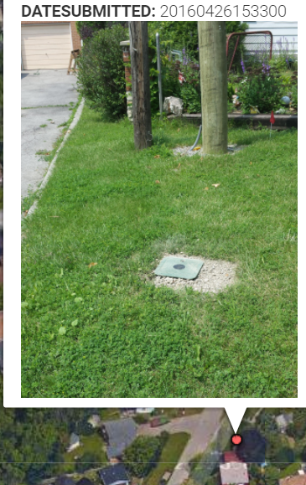
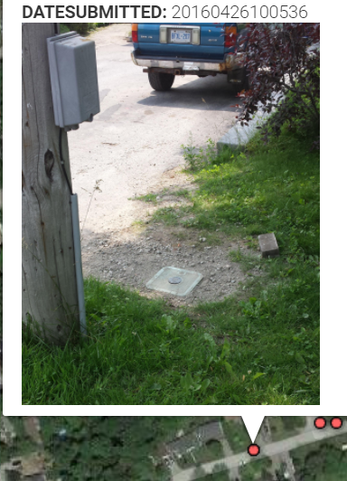
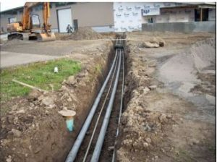
Notes:
47 minutes

Slide 17
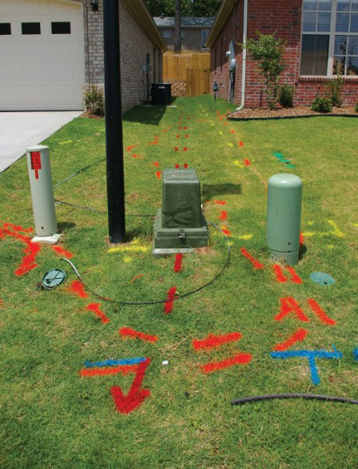
Locator Images
Are we missing an opportunities?

Slide 18
Utility Mapping
“S250 can help ensure that accurate information about underground utility infrastructure is captured and available for future projects”

Slide 19
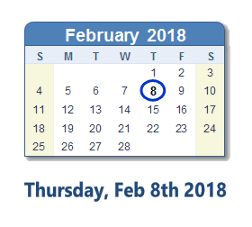
What does the future look like?
Notes:
Today. It looks like today.
But we can do better…..

